Slide 1


AAI 521 – Deep-Learning Based Plant Disease Detection
Ricardo Barbosa December 09, 2024 Fall 2024

Slide 2
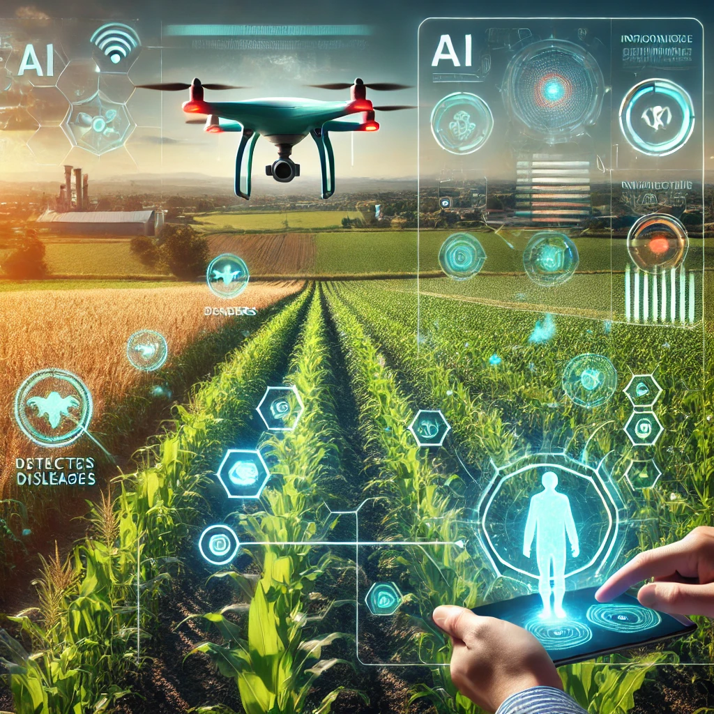
The Problem in the Field
Hidden threats in the crops, late detection = ruined harvest.
What if we could detect disease with a tap?

Slide 3
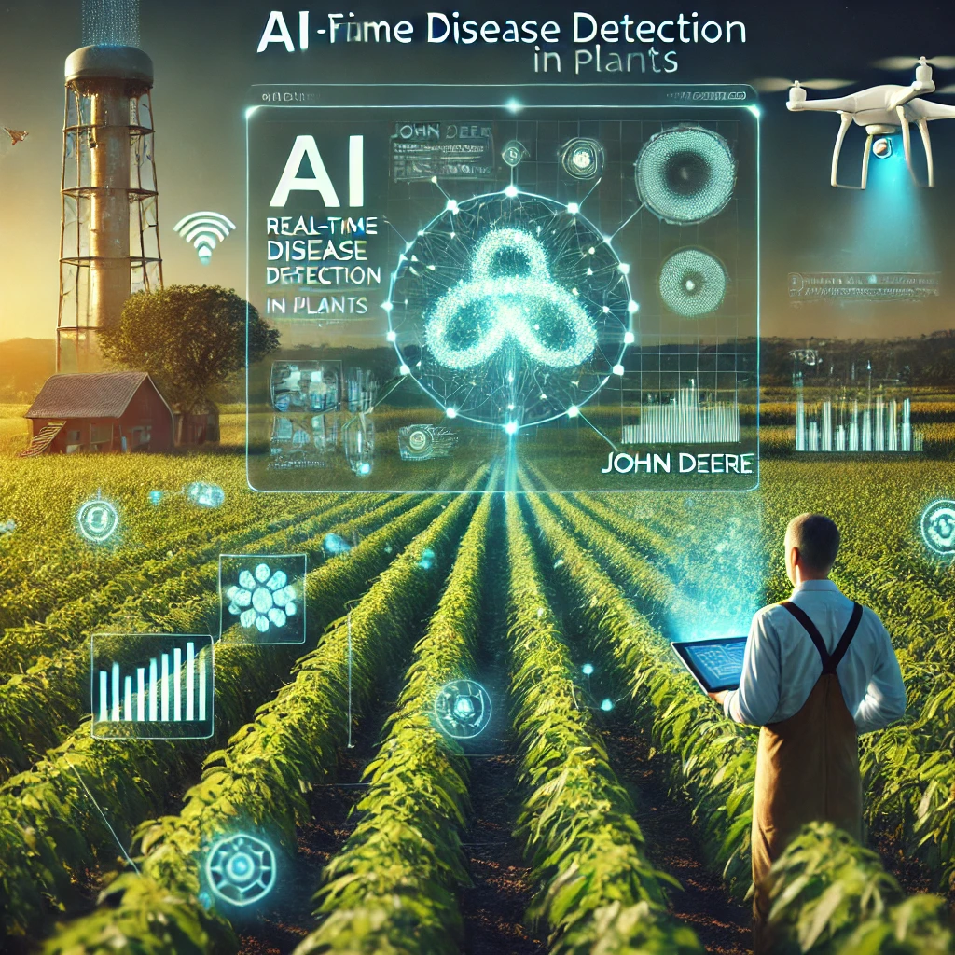
Motivation: Why This Matters
Inspired by John Deere’s mission to support farmers
Manual detection is slow and error-prone.
Goal: Real-time, AI-driven disease detection.
The temptation to ad complexity led to confusing results, but returning to simplicity brought clarity.

Slide 4
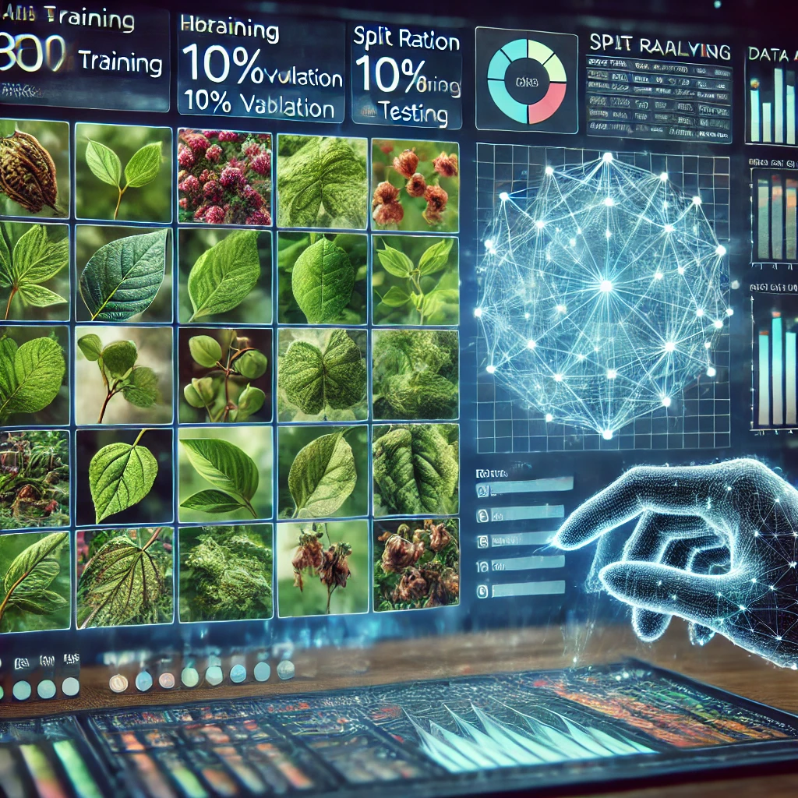
PlantVillage Dataset
PlantVillage dataset: 20,638 images across 15 classes.
Split: 80% training, 10% validation, 10% testing.

Slide 5
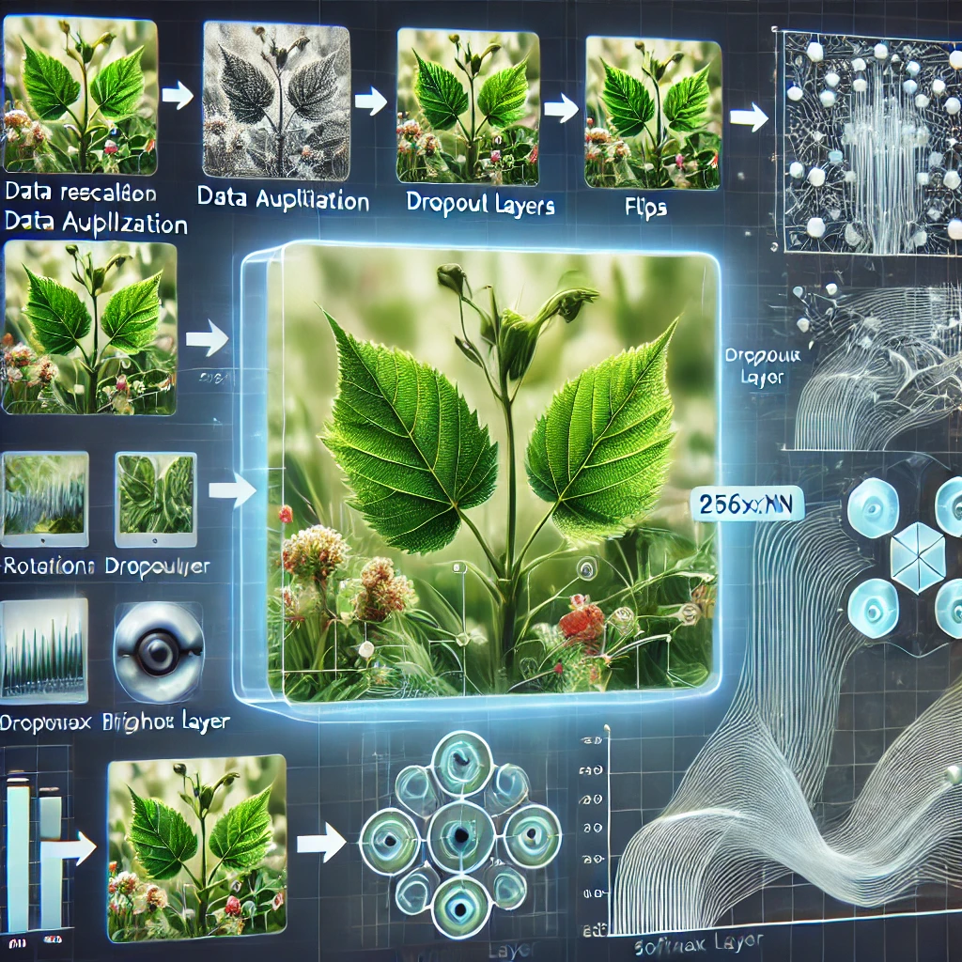
Methodology
Rescaling, resizing, data augmentation.
CNN with 3 convolutional blocks, dropout, and softmax output

Slide 6
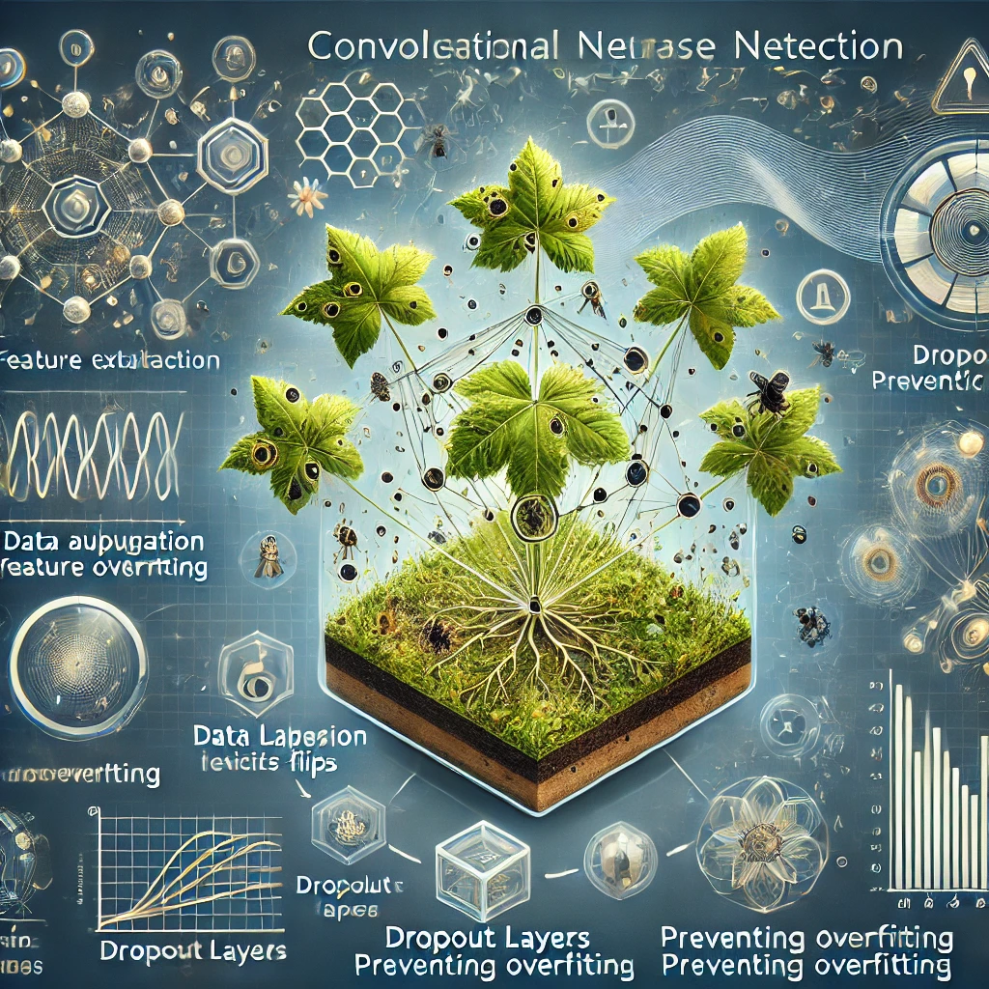
Why CNNs and Techniques?
Feature Extraction: Detects disease patterns
Data Augmentation: Adds variability
Dropout: Prevents overfitting
Learning Rate Scheduling: Ensures stable training

Slide 7
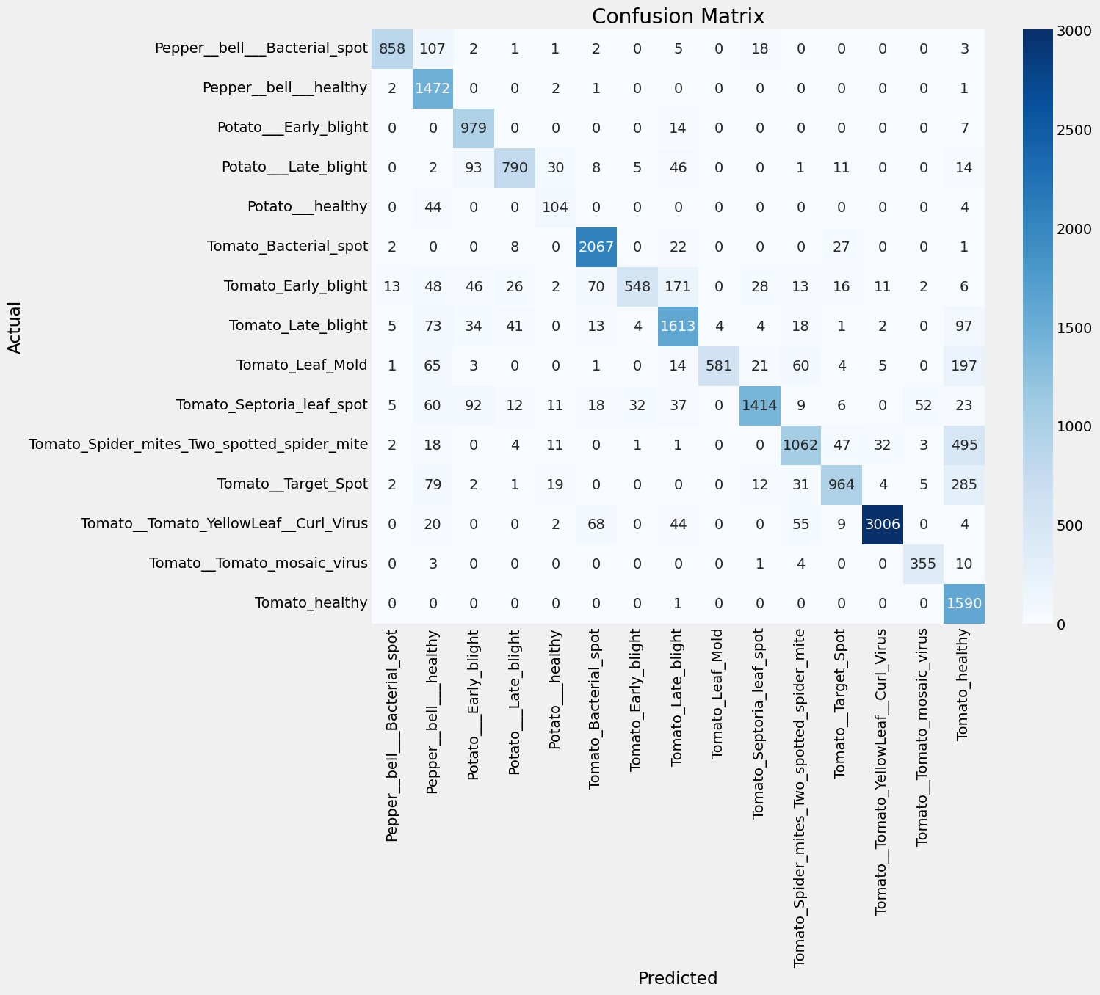
Results - Confusion Matrix
Accurate Predictions
Areas for Improvement

Slide 8
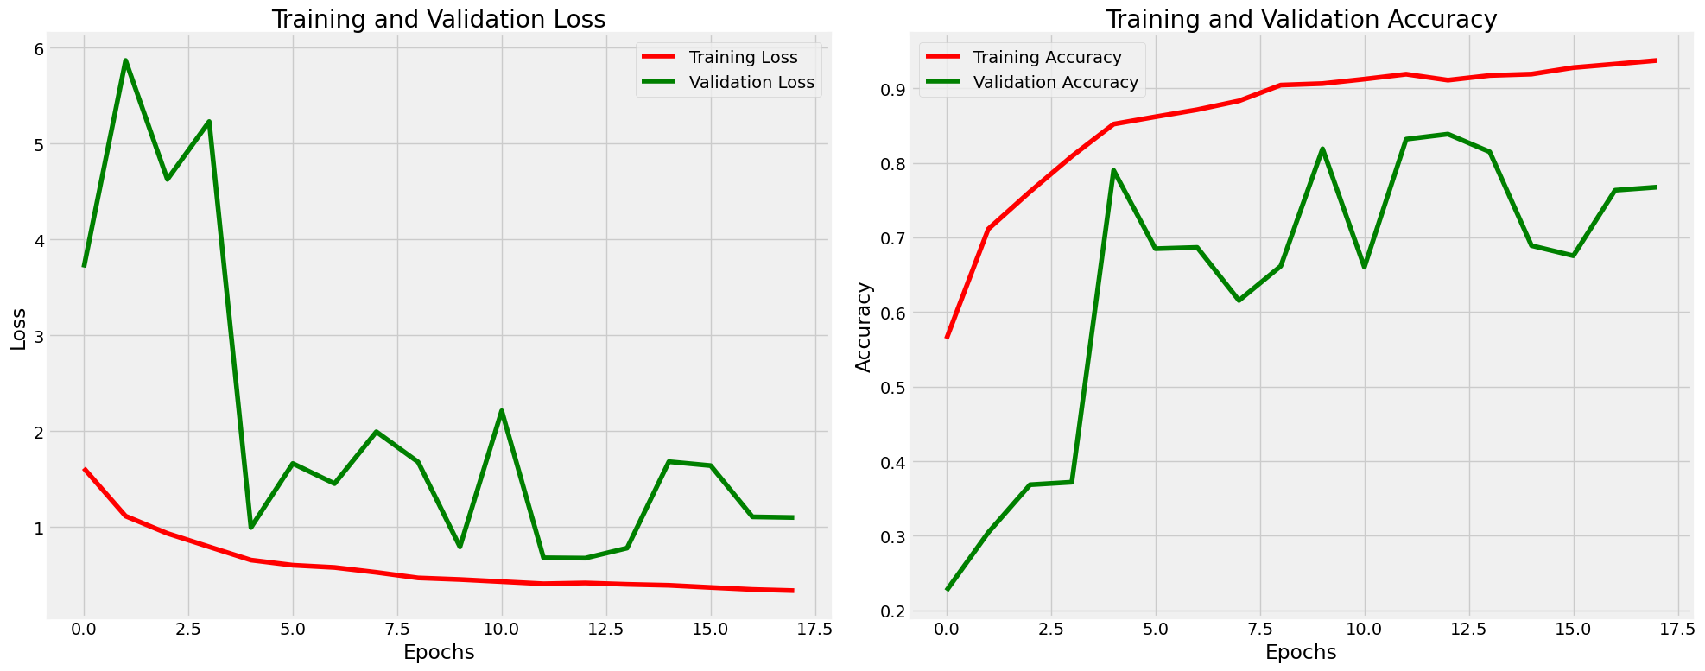
Results - Training/Validation Curves
95% training accuracy,
75% validation accuracy.

Slide 9
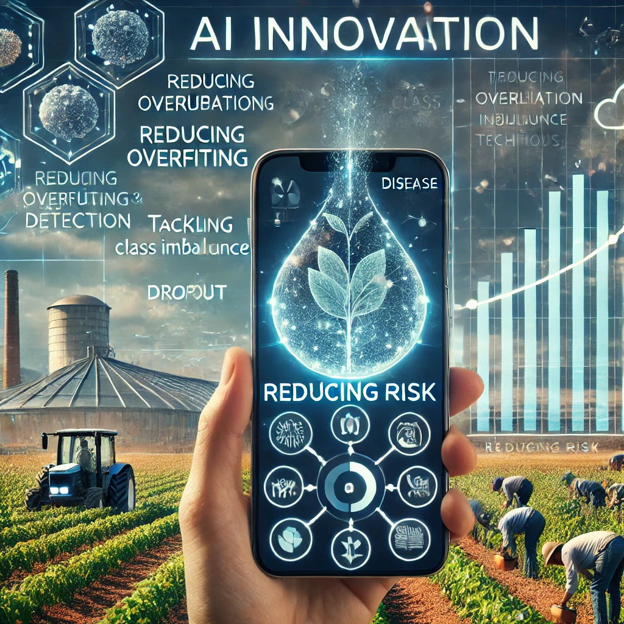
Innovation Curve - Reducing Risk
Tackled overfitting and class imbalance.
Ready for mobile deployment.
Proven accuracy and efficiency.

Slide 10
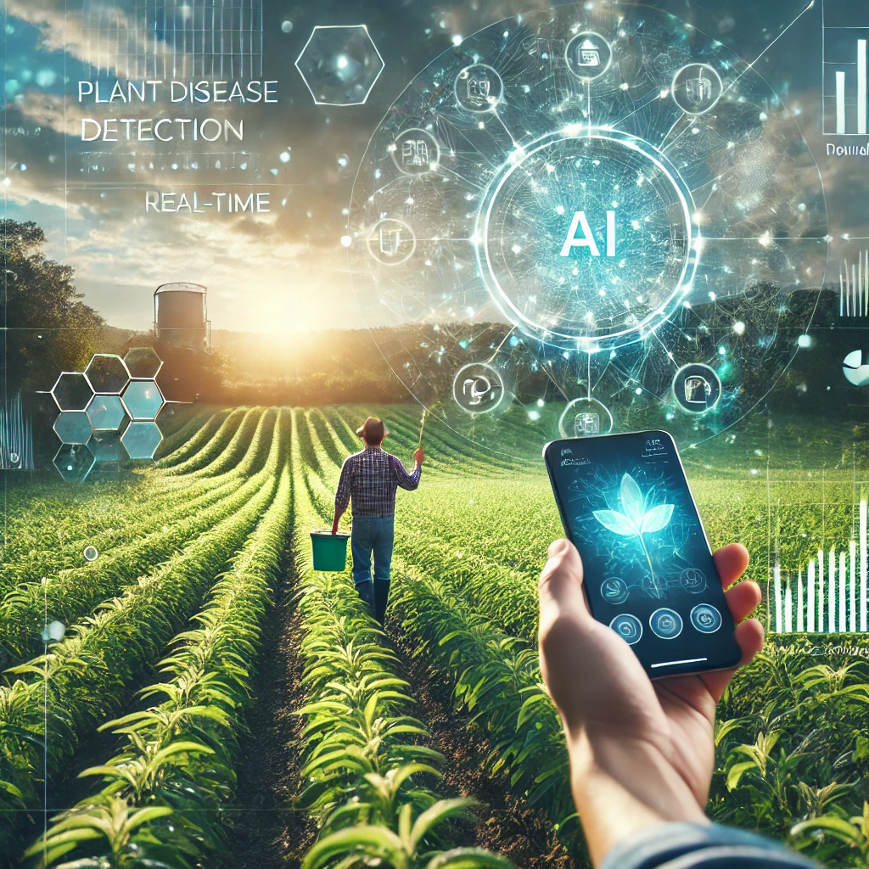
Conclusion - Future Vision
AI tools can revolutionize farming.
Future: Mobile apps for real-time diagnostics.
Goal: Work with John Deere to make this a reality.

Slide 11


